Slide 1
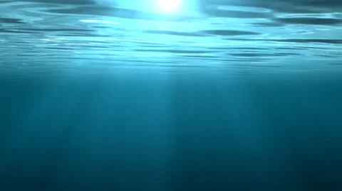
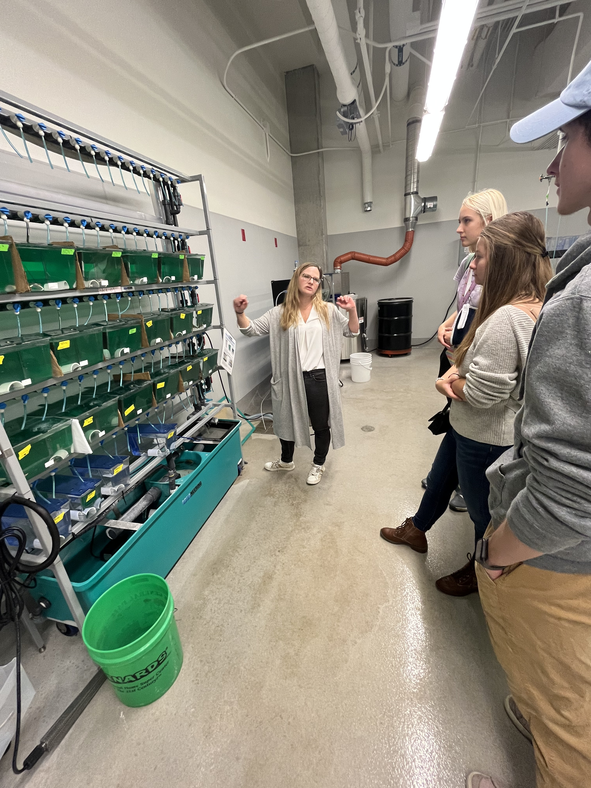
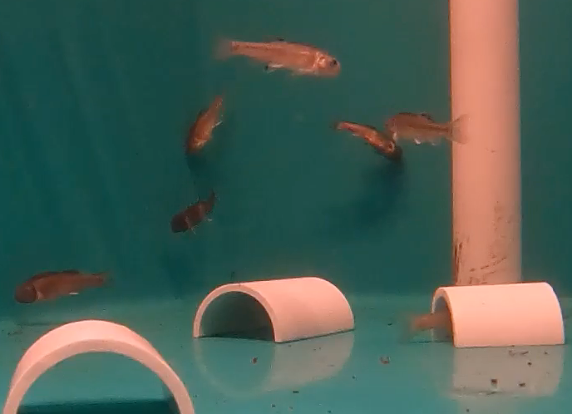
“Learning to Survive”
“Learning to Survive”
Modeling Learning in Embryonic Minnows
Modeling Learning in Embryonic Minnows
Brooke Karasch, Rileigh Lancaster, Alyssa Linville, & Tom J. McConnell
© 2023 Ball State University
NSF project #2152668

Slide 2
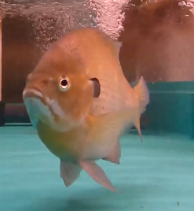
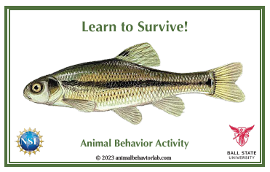
Learning to Survive
Instructions
You have a card to tell you if you are a “Control” or “Conditioned” fish. Don’t show anyone what’s on the inside of your card!
As you watch the video, Conditioned fish know which fish is the predator (see the picture on the card!) and how to “respond” when you see a predator.
If you are a “Control” fish, you need to learn how to spot the predator and what to do when you see it. Learn by watching others!
If you fail to respond, or respond at the wrong times, you MIGHT be ”killed” by a predator! Try to learn to survive!
Play the video on the next slide, or click here: https://youtu.be/9B0MkocQDJs

Slide 4
Discussion Questions
Let’s talk about the activity!
If you were a control fish, did you figure out what the cue was that the conditioned fish were responding to? What was it?
2. What do you think the words “control” and “conditioned” mean in the context of this activity?
Discuss briefly with nearby classmates: if you were a control fish, how close were you sitting to a conditioned fish? How quickly did you learn the response? Do you think the distance made a difference to how quickly you learned?
What does “response” mean in this context?
Do you think social learning makes a difference for animals? Why or why not?

Slide 5
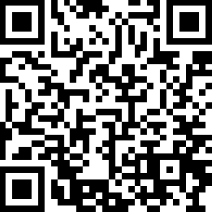
Find more digital learning resources at
https://strides.bsu.edu
STRIDeS Project

