Slide 1


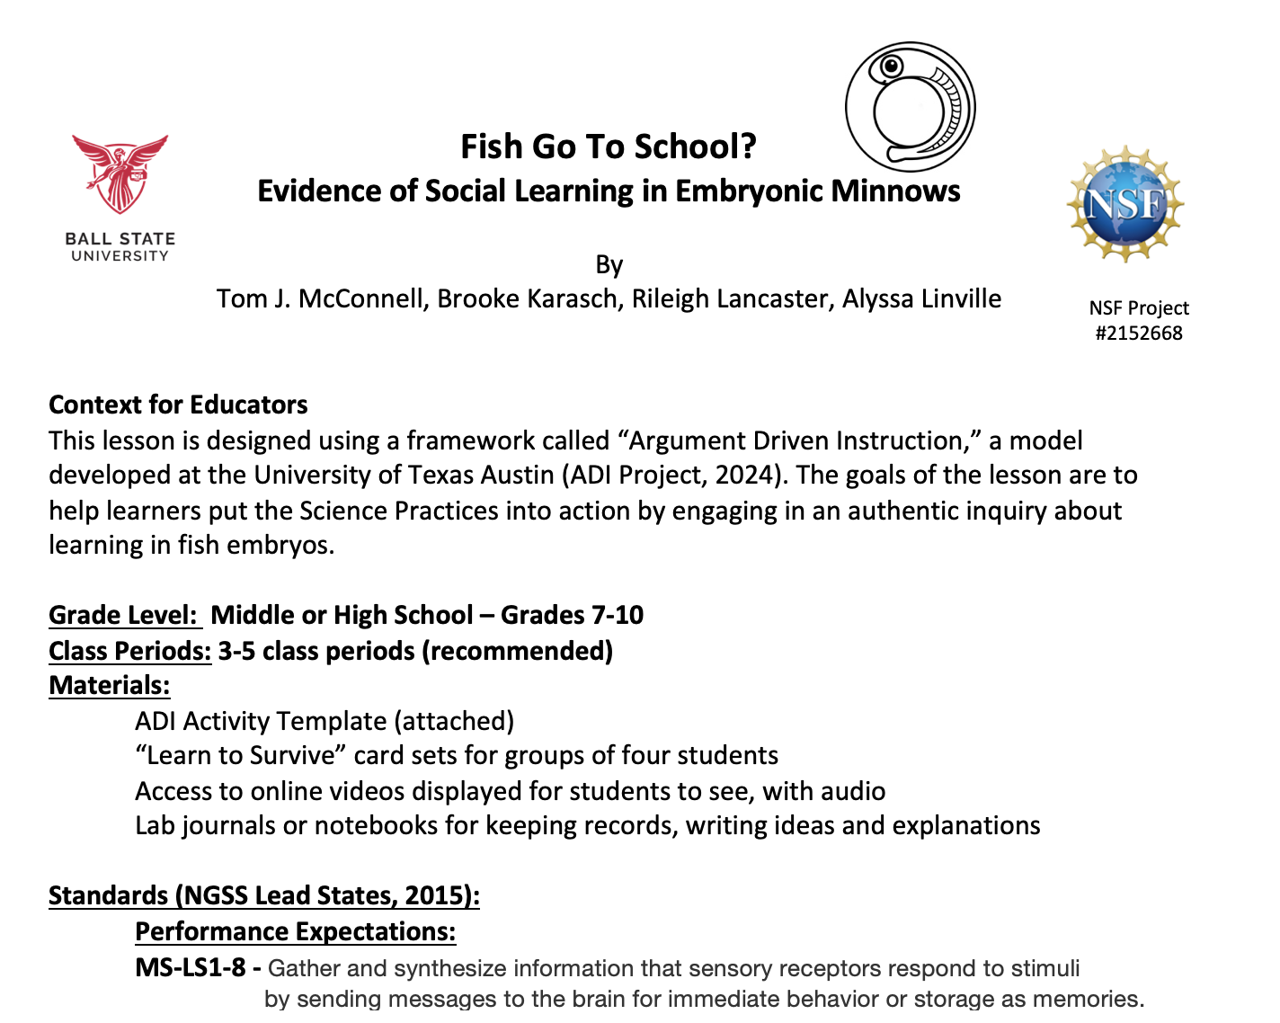

Fish Go To School?
An ADI Unit Plan
A lesson plan with multiple components
Built on ADI framework
Fish Go To School
Shared Folder

Slide 2
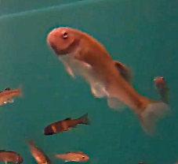
Fish Go To School?
An ADI Unit Plan
STAGE 1: Task – Part 1
See page 1 of the Student Packet and use the handout
to record your ideas.
Stage 1, part 1
Fish can sense things in their environment by smell. Chemicals given off by other fish float around in the water, and other fish use those chemicals to know what is going on around them. What would be important for a fish to sense their environment? Write down some initial ideas before you watch the video.
After you record your initial ideas, Click to view Video #1.
https://youtu.be/oMJ01ugKRU0

Slide 3
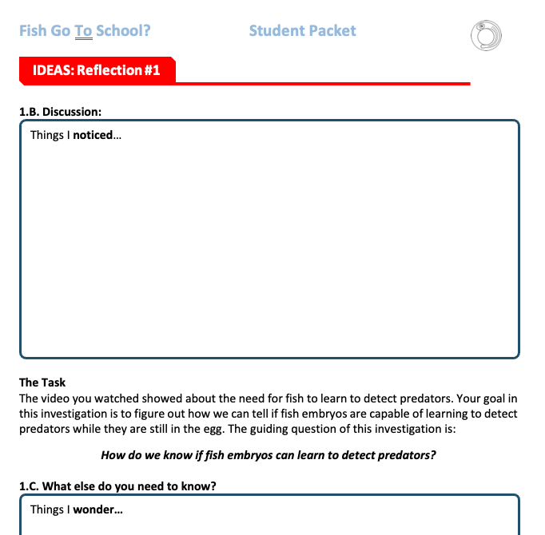
Fish Go To School?
STAGE 1: Task – Part 2
Use the template to write down what you noticed and want to know more about.
When you’re done, view Video #2
https://youtu.be/tgZTRq7W1cY

Slide 4
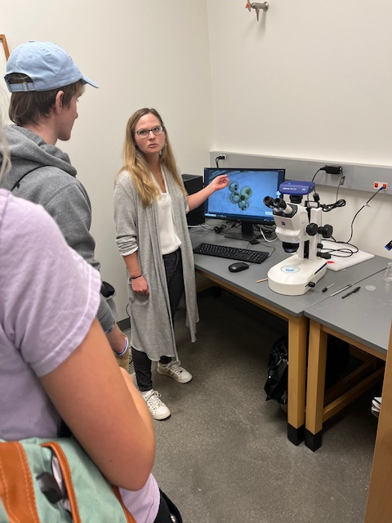
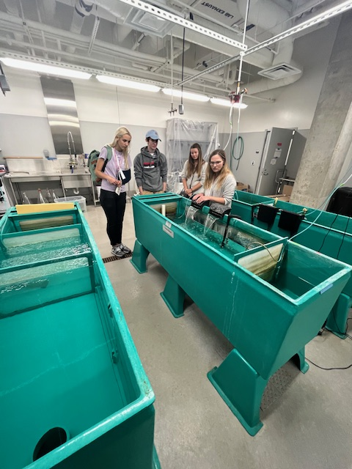
Fish Go To School?
STAGE 2: Ideas
In the videos, there are three “Core Ideas” that may help you understand the phenomenon you saw in the videos as you plan an investigation.
Read through the Core Ideas in the Student Packet, and write/discuss how those ideas may be helpful in planning an investigation.

Slide 5
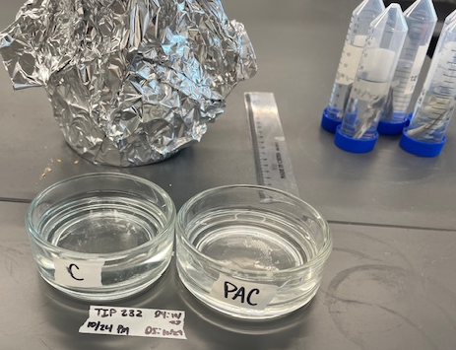
Fish Go To School?
STAGE 3: Plan
Experiment by the Fish Behavior Researchers
Materials – Fish eggs, AC chemical, PC chemical, Microscope and camera to observe embryos.
A group of fish embryos were introduced on Days 2-3 to both Alarm Cue (AC) and Predator Cue (PC).
You will watch 2 videos recorded on Day 5.
Embryos BEFORE any cues added
Embryos after PC was added
Write a plan for how you will record data that can help you determine if the fish embryos have learned to associate PC with “danger!”

Slide 6
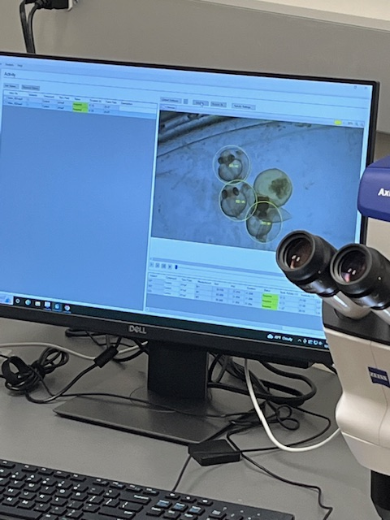

Fish Go To School?
STAGE 4: Do
When you have a plan for recording data while watching the videos,
click the link to see Video #3.
https://youtu.be/eyjiBx7PERM

Slide 7
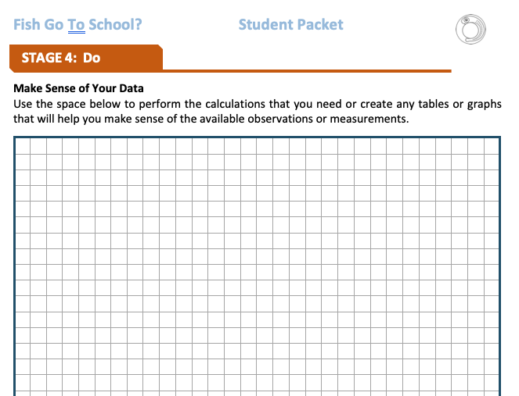
Fish Go To School?
STAGE 4: Do
Making Sense of Your Data
Use a table or graph your data to help you compare the BEFORE and AFTER videos.
Discuss what patterns you see?

Slide 8
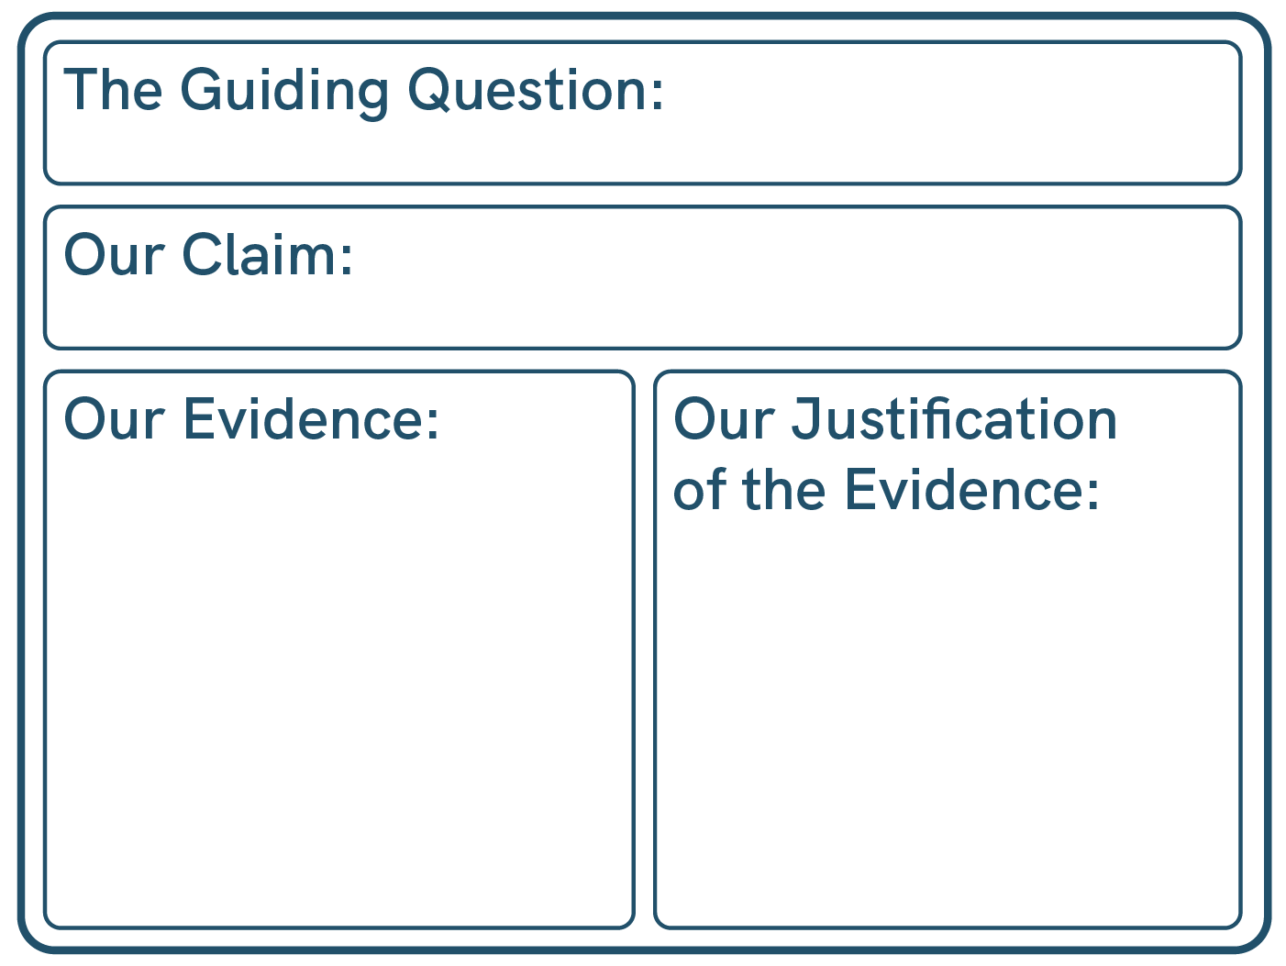
Fish Go To School?
STAGE 5: Share
Develop a “Draft Argument” on the White Board
You will SHARE your claims with the class!

Slide 9

Fish Go To School?
STAGE 6: Reflect
Peer Review for Draft Arguments
Get feedback from your peers about your Draft Arguments
Discuss the feedback with your group. How can use the feedback to improve your Argument?

Slide 10

Fish Go To School?
STAGE 6: Reflect
How could you improve how you did the investigation?
What sources of error or variation?

Slide 11
Fish Go To School?
STAGE 7: Create a Report
Use the template in your Student Packet to plan and write your report.
Then share that report with THREE peers to get feedback on the “Report Peer Review Guide”
Use the feedback to REVISE your report!
Then turn in the Report and your Peer Review Guide. The teacher will score the report using the rubric in the Peer Review Guide.

Slide 12


Find more digital learning resources at
https://strides.bsu.edu
STRIDeS Project

